Slide 1





WebGIS design
Comparing
ArcGIS Online,
Mango,
and Leaflet Javascript / HTML / CSS
By Nicolas Lopez, for GG5569
Access All Data
https://nicolaslopez.me
Click

Slide 2
Plan
Data.
Design.
Comparison.
Discussion.
Conclusion.

Slide 3
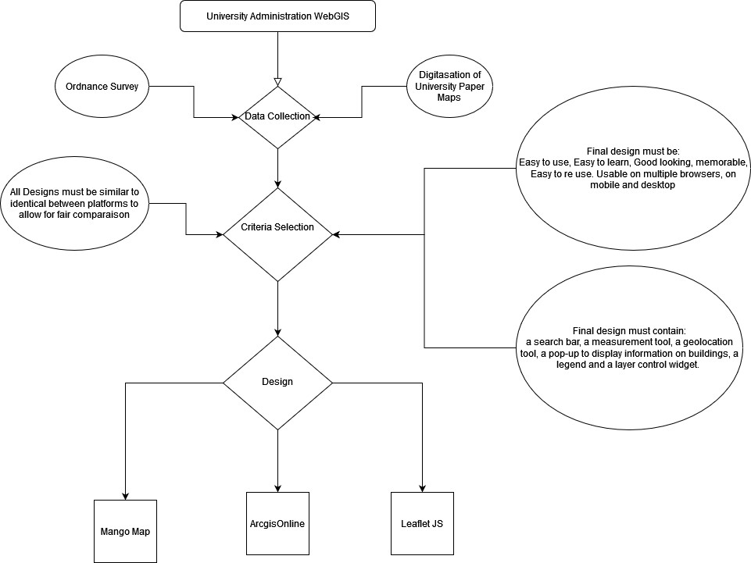

Slide 4
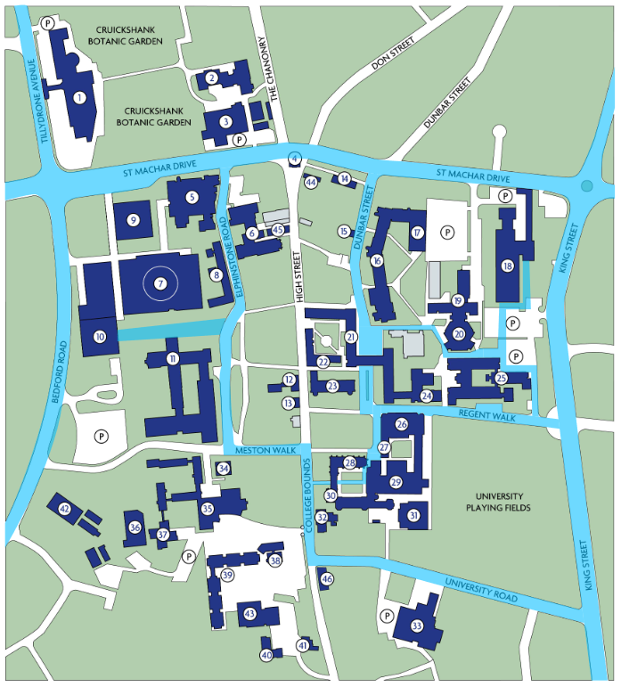
Data: University administration
Theme assigned: University Administration.
The University of Aberdeen has no WebGIS application.
Students and staff need to download outdated pdfs of maps for:
Building names and locations.
Notable sites.
School locations.
Accessibility!!!
No data online on:
Library occupancy, although data collected and displayed on campus.
Campus map available to download at https://www.abdn.ac.uk/about/campus/maps/download.php

Slide 5
Data: University administration
Data collected:
Accessibility:
Roads and paths (OS Survey).
Bike parking (OS Survey).
Cycle lanes (OS Survey).
Wheelchair accessible roads (digitised from map available at https://www.abdn.ac.uk/about/campus/maps/download.php )
Administration:
Buildings (digitised from map available at https://www.abdn.ac.uk/about/campus/maps/download.php ):
Notable sites within building.
School location.
Library Occupancy.
Data was modified and unified within ArcGIS pro and was then exported as shapefiles and GeoJSONs.
Campus map available to download at https://www.abdn.ac.uk/about/campus/maps/download.php

Slide 6
Design
Final design must be:
Easy to use,
Easy to learn,
Good looking,
Memorable,
Easy to re-use,
Usable on multiple browsers, on mobile and desktop.
Final design must contain:
a search bar,
a measurement tool,
a geolocation tool,
a pop-up to display information on buildings,
a legend and a layer control widget.

Slide 7

ArcGIS Online https://nicolaslopez.me/arcgis

Slide 8
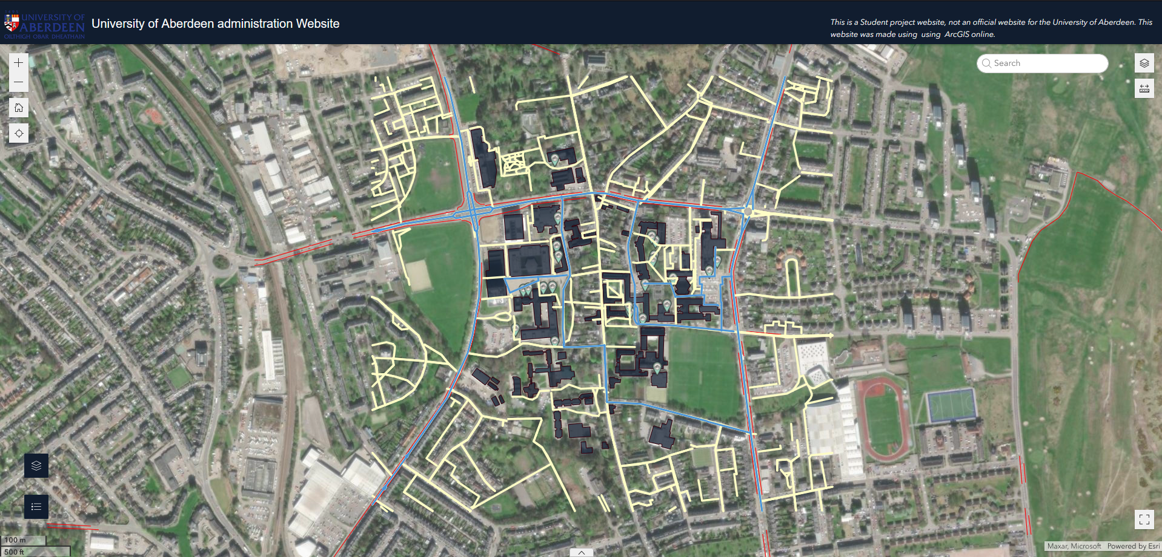

Slide 9
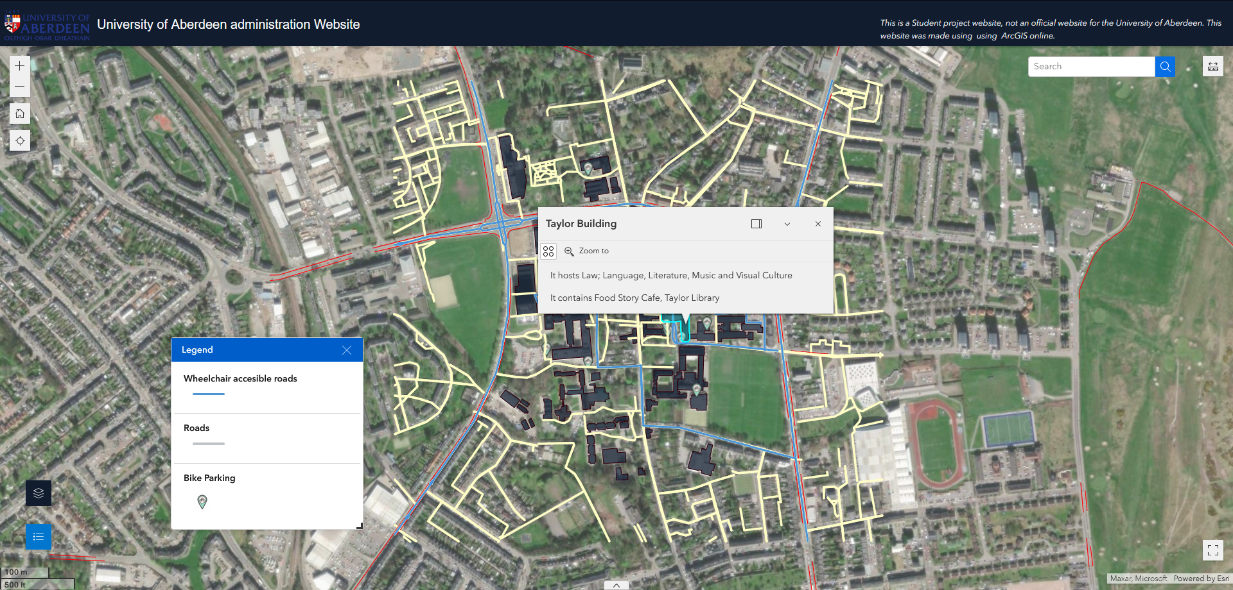
Header
Zoom tools
Home tool
Geolocation tool
Search tool and measure tool
Movable and Scrollable Legend
Pop-up for building information
Legend and layer widget
Fullscreen tool

Slide 10
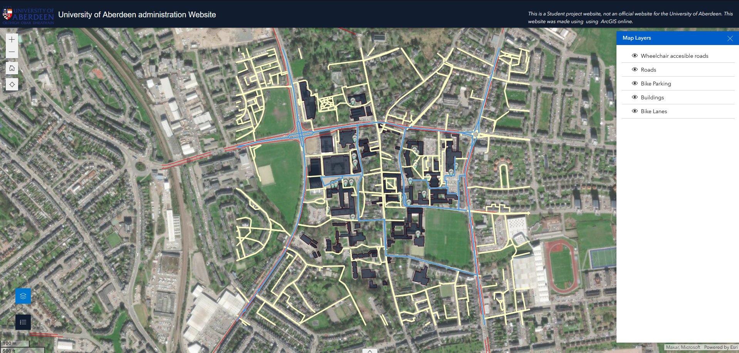
Layer pan

Slide 11
ArcGIS Online https://nicolaslopez.me/arcgis
Experience:
Creation:
Easy to use and design.
Interface user friendly.
Need subscriptions (here provided by university).
Large catalogue of data and basemaps.
Limiting in some design aspect, likely to keep the recognisable Esri icons and designs.
Using ArcGIS Experience, you must re-publish any change made.
Easy to design for mobile.
User:
Esri familiar interface.
Search tool has shown to not be the most efficient.
Easy to use.
Recognisable and easy to re-use.
Mobile friendly.

Slide 12

Mango Map https://nicolaslopez.me/mango

Slide 13
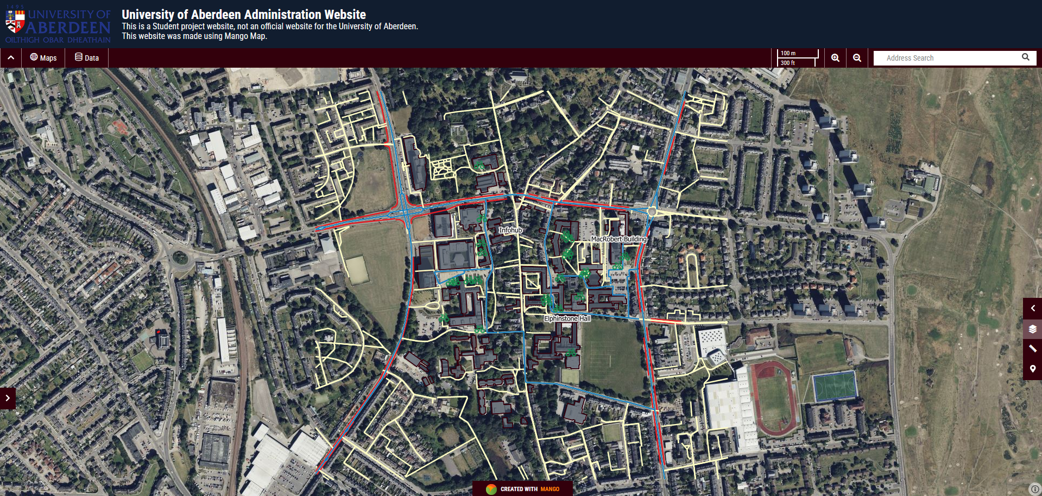

Slide 14
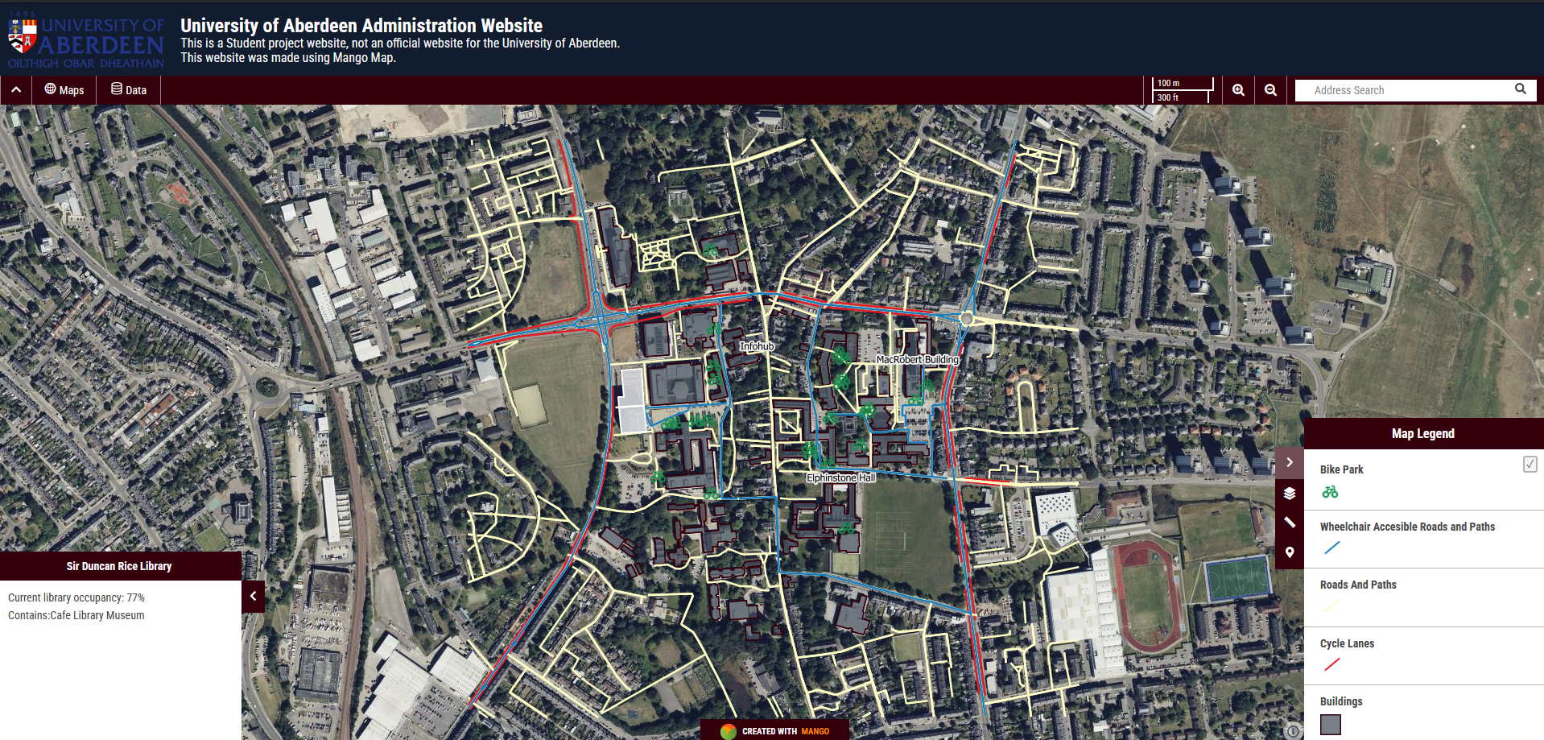
Header
Zoom tools
Search Tools
Scale
Pop-up for building information
Geolocation tool
Measure tool
Legend

Slide 15
Mango Map https://nicolaslopez.me/mango
Experience:
Creation:
Use and design could be better, cannot edit the map directly, always edit through an editing panel.
Interface user friendly, sometimes slow.
Need subscriptions (here free trial).
Limited catalogue of basemap and unable to import a tile layer as a basemap.
Very limiting in some design aspect, cannot import icon, change the location of pop ups.
Changes are updated instantly.
Useful JavaScript options to add conditional pop-ups for example.
User:
Clear and easy to understand interface.
Very useful tool bar on top.
Feels very pre-made, not very organic.
Mobile friendly.

Slide 16

Leaflet JS https://nicolaslopez.me/webgis

Slide 17
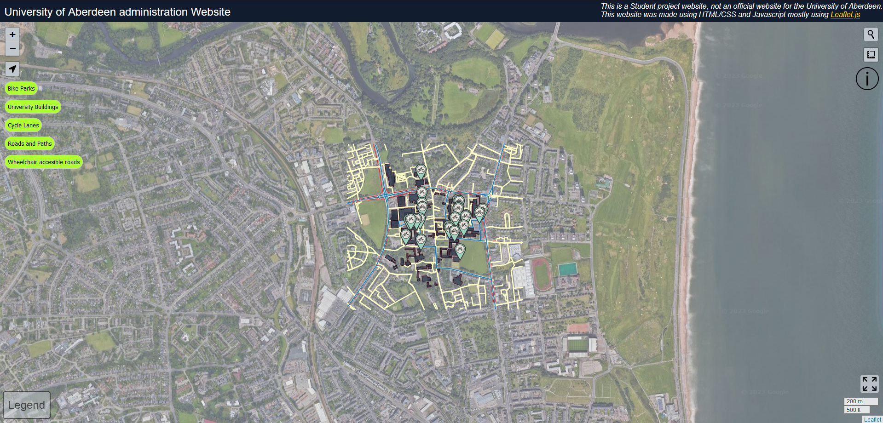

Slide 18
Header
Zoom tools
Geolocation tool
Search tool and measure tool
Hover Information tool
Layer Control
Fullscreen tool
Hover Legend

Slide 19
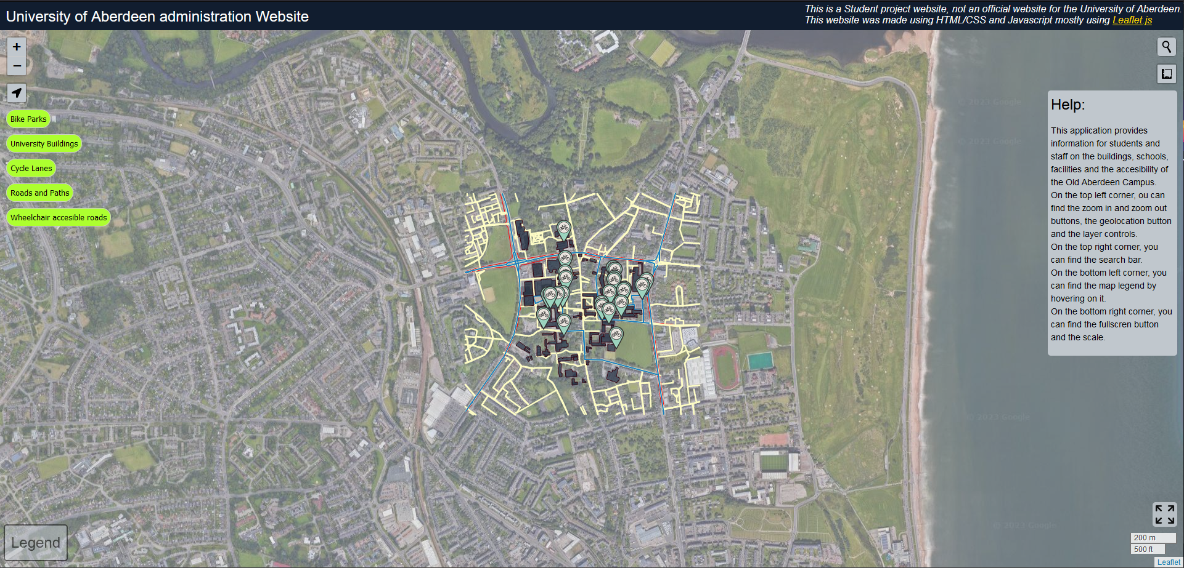
Hover Information tool once hovered

Slide 20
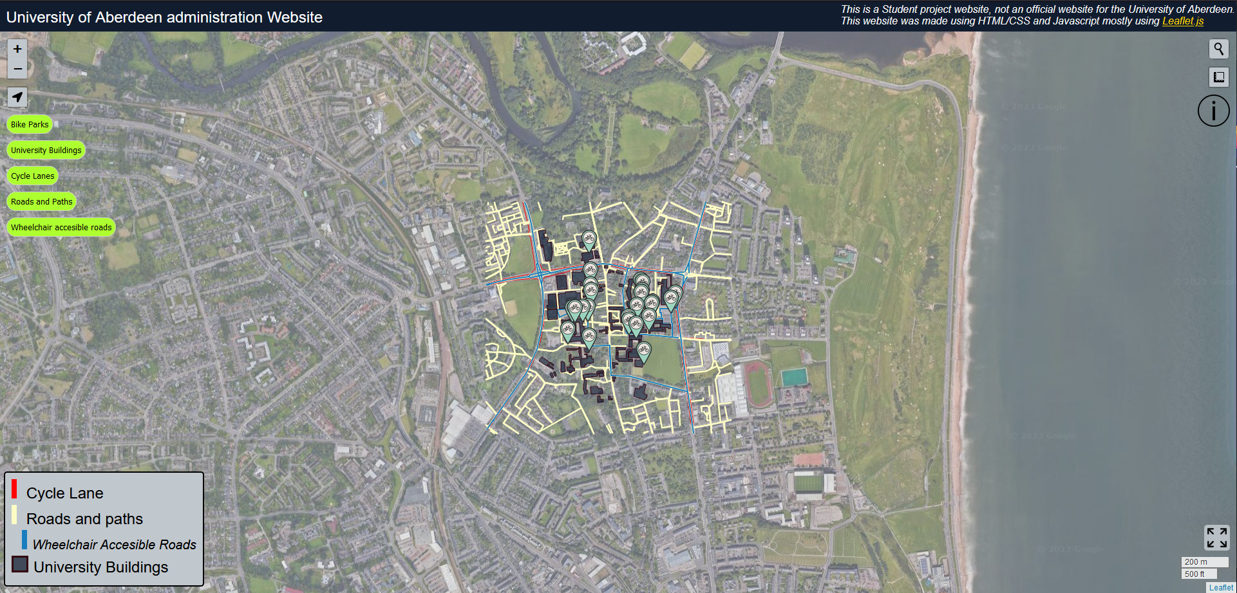
Hover Legend once hovered

Slide 21
Leaflet https://nicolaslopez.me/webgis
Experience:
Creation:
Difficult to use and design, requires proficiency in html/CSS and JavaScript
Little to no-limit in design freedom, immense library of plug-ins.
Open source and regularly updated.
Design is skill dependant of creator.
Time-consuming.
Free
User:
Highly subjective as completely designed by me.
Simple but effective, easy to read.
Could improve on mobile friendliness, as layer toggles seem to have an animation bug on mobile.
Original.

Slide 22
Conclusion
Although ArcGIS online confirms why it is a leader on the market, with easy-to-use products create a great user-friendly experience; Mango Map is a serious opponent, with an effective design, although limiting during creation, it is very effective on the user-end, where sometimes the Esri design can be inefficient (e.g. pop-ups). Leaflet JS as a JavaScript plug in to create from scratch a webGIS app stands out in the good and bad. Offering a complete freedom, of design in an inexpensive way. This method is difficult to learn, as it is dependent on coding, but also is likely to be more time- consuming.

